Slide 1

Project Work-II Presentation on Fake News Detection using Supervised Learning Method
Presented By:-
Swapnesh Jain
(EN16CS301272)
Project Guide:-
Dr. Ruchi Patel
Prof. Sachin Solanki

Slide 2

Content
Introduction
Project Objectives
Problem Domain
Solution
Methodologies Used
Dataset & Platform Specification
Pre-processing
Proposed Solution
Screenshots
Result and Discussion
Conclusion & Future Work
Journal Details

Slide 3
Introduction
With the information revolution now being a real thing and virtually every person with a smartphone in hand and a working internet connection being a content creator everyone has to deal with a new menace of fake news almost every day with social media being its breeding ground. With more and more people being introduced to social media every day and it is a great influence on the opinion-forming process of the people, there are people with vested agendas who want to use these information as a means to propel their agenda.
Many scientists believe that this problem can be dealt by using Machine Learning techniques with Artificial Intelligence. Hence this paper describes a comparative study of four most popular machine learning methods to identify and determine which method produces the best results while detecting fake news.

Slide 4
Project Objectives
To design an algorithm and model that will detect whether a news is fake or not.
To evaluate the performance of different machine learning models using confusion matrix and accuracy.
Comparative study between the accuracies and confusion matrices of different models for different datasets.

Slide 5
Problem Domain
One of the problem is that most of the news are gathered from various sources present on the web, therefore the information obtained from these news cannot be relied on and these sources cannot be trusted because the true origin of most of these news (present on the Internet) is not known.
Also over the past few years spreading of rumours and misinformation has reached a point that it has begun to affect social issues and political problems.
Another problem is that the amount of time spent on social media has increased at an alarming rate. Thus most of the fake news are acquired from these sources. Social media provides anonymity while expressing out opinions which greatly reduces the authenticity of news received from these sources as compared to a newspaper or any other trusted media.

Slide 6
Solution
The solution for all these problems lies in designing and implementing various machine learning models and training them using dataset (containing news articles that are already classified into fake and real ones), that can be used to predict whether a given news is fake or real. And the probability for the news to be true can be checked using the accuracy obtained from these predicted models.

Slide 7
Methodologies Used
For classification problem we have used four popular machine learning models in this study which are as follows:
1 Naïve Bayes (NB)
Naive Bayes algorithm is a simple but an efficient technique for the construction of classifiers. It consists of models that label problem instances as classes, which are represented as feature-vectors. All NB classifiers work on the assumption that for a given class variable the value of a feature does not depend upon the value of any other feature.
2 Logistic Regression (LR)
Logistic Regression algorithm is applied when the dependent or the target variable is categorical in nature. In its basic form LR is a statistical model which makes uses of a logistic function for modelling a binary dependent variable. The characteristic feature that defines the logistic model is that when value of one of the independent variable increases multiplicatively, the probability of the second variable gets scaled at a constant rate, where each independent variable has its own parameter; this feature generalizes the odds ratio for a binary dependent variable also.

Slide 8
3 Random Forest (RF)
As the name implies, Random forest is a model that consists of numerous individual and independent decision trees that function simultaneously as an ensemble. Each individual trees in the RF returns a class as a prediction and the class that attains the highest number of votes becomes the prediction of the entire model. The distinguishing feature of RF is that when a fairly large number of independent trees work together, they outperform any other standalone model.
4 Extreme Gradient Boosting (XGBoost)
Extreme Gradient Boosting (herein after referred to as XGBoost) is an ensemble machine learning algorithm that is based on the concept of decision trees and works on the framework of gradient boosting. In such prediction problems that deal with the data in the unstructured form (images, text, etc.) artificial neural networks tend to outdo the performance of all other algorithms and frameworks working with similar problems.

Slide 9
Dataset
To implement each method two different datasets are gathered for this projects, namely Kaggle and Liar.
The first dataset is of Kaggle which includes 16,548 human labelled news articles described by five columns namely ‘id’, ‘title’, ‘author’, ‘text’ and ‘label’ (categorized as 0, indicating real news and 1, indicating fake news).
Second dataset is of Liar which includes 10,240 human labeled news articles described by two columns namely ‘statement’ and ‘label’ (categorized as true and false).
Platform Specification
Anaconda Spyder IDE has been used as a python development environment to build and train machine learning models for detecting fake news using built-in packages and libraries.
The project has been carried out using Python language because it provides a great choice of libraries and packages to carry out most of the tasks to build machine learning models. Also Python has a great community support because most of the programmers contribute to help each other.

Slide 10
Pre-processing
First both the datasets are observed to look for what type of data each methods are dealing with. But upon closely observing datasets it was found that both the Kaggle and Liar datasets contain missing values and incomplete news articles. But Kaggle dataset along with missing values and incomplete news articles contains news from different languages also. So to increase the efficiency of each models these missing values along with the news articles which are incomplete and of different languages are eliminated.
After eliminating these type of data all the special characters (or say punctuation marks and tags) along with the stop-words are removed. The stop-words are those words that do not contribute much in predicting whether the news is real or fake, instead they just introduce confusion to each model. Some of these commonly used stop-words are "a", "the", "of", "I", "you", "it", "and", etc. Rather machine would not want these words taking up space in the database, or taking up valuable processing time. Therefore eliminating them will improve the efficiency of the model. After the soft-words are removed, stemming was carried out to reduce the words to their roots, using Python’s Porter Stemmer package.

Slide 11
Proposed Solution
Proposed solution consists of following important steps for detecting fake news using different supervised machine learning models:
Two different datasets, Kaggle and Liar, were gathered to implement each model.
Then techniques like Tokenization, Stemming and removing punctuation marks, tags, and stop-words were used to clean the dataset.
Then different pre-processing techniques such as CountVectorizer, Term Frequency-Inverse Document Frequency, n-gram like bigram and trigram were used on the datasets to build the vocabulary of the count vectors.
The models then were build using Naive Bayes, Logistic regression, Random Forest and XGBoost.
Finally performance was evaluated for these different models and compared using their accuracy and confusion matrix.

Slide 12
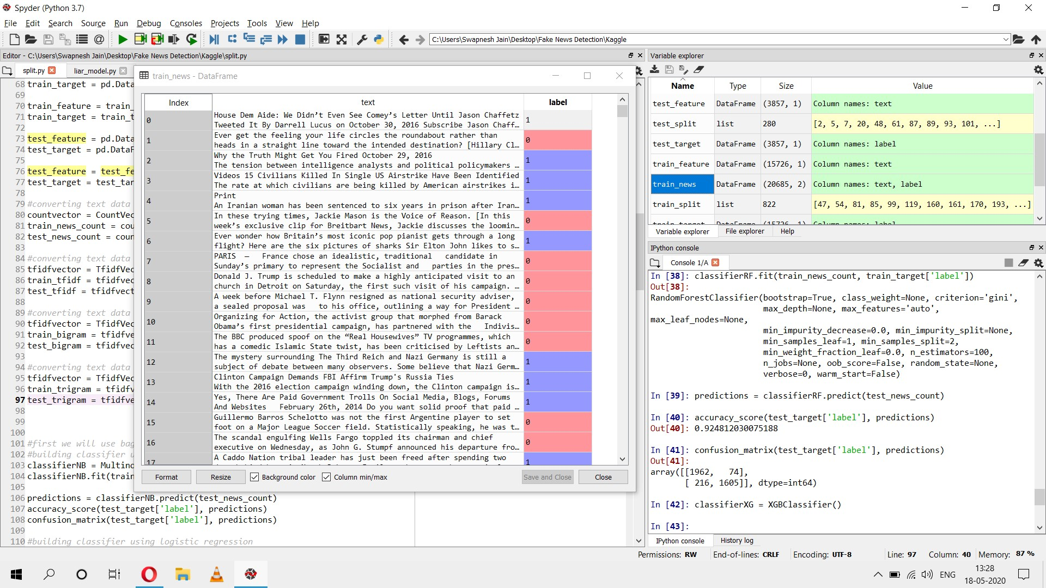
Screenshots

Slide 13
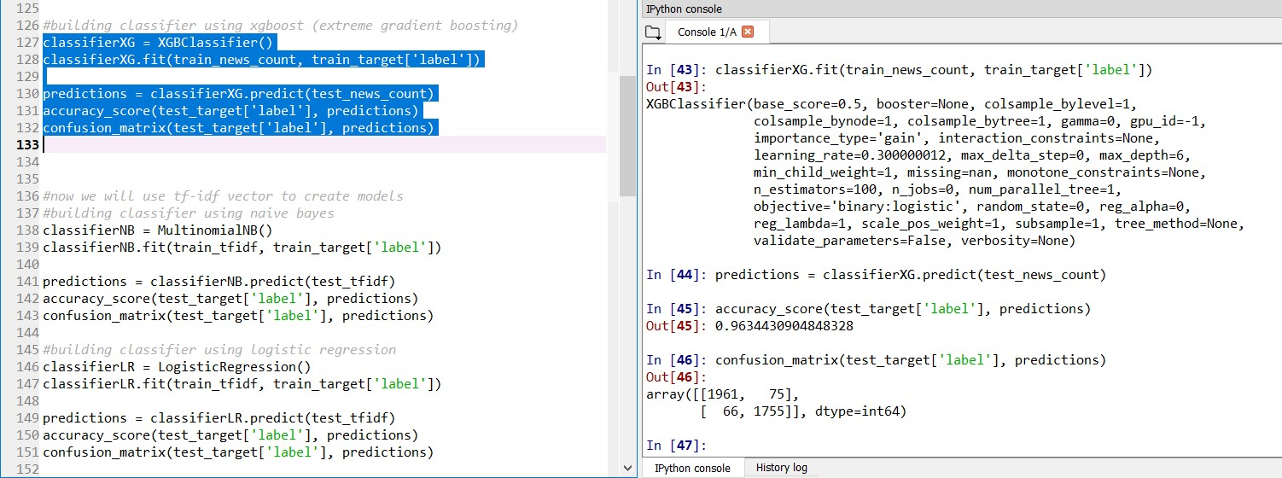

Slide 14
Result and Discussion
The model was trained and tested for both the datasets. In this project two techniques for pre-processing, namely ‘CountVectorizer’ and ‘TF-IDF’, and four methods of machine learning (discussed in Methodologies) are used and confusion matrix along with accuracies are obtained and tabulated.
3.5.1 Experimental Result on Kaggle Dataset
Table 3.1 describes in detail the labels obtained from various prediction methods and also the extent of correctness. CountVectorizer along with various prediction methods was applied on Kaggle dataset to obtain this table.
With Naïve Bayes classifier, 3489 correct and 368 incorrect predictions are obtained. With Logistic Regression, 3680 correct and 177 incorrect predictions are obtained. On applying Random Forest, 3529 correct and 328 incorrect predictions are obtained. Finally while applying XGBoost, 3716 correct and 141 incorrect predictions are obtained.

Slide 15
Table 3.1. Confusion Matrix when CountVectorizer was used as pre-processing technique on Kaggle dataset
Classification Algorithm | Label | Actual Positive | Actual Negative
Naïve Bayes | Predictive Positive | 1938 | 98
 | Predictive Negative | 270 | 1551
Logistic Regression | Predictive Positive | 1957 | 79
 | Predictive Negative | 98 | 1723
Random Forest | Predictive Positive | 1975 | 61
 | Predictive Negative | 267 | 1554
XGBoost | Predictive Positive | 1961 | 75
 | Predictive Negative | 66 | 1755

Slide 16
Table 3.2. Accuracy table for CountVectorizer technique on Kaggle dataset
Classification Algorithm | Accuracy %
Naïve Bayes | 90.45
Logistic Regression | 95.41
Random Forest | 91.49
XGBoost | 96.34
Table 3.2 contains the consolidated data for accuracy of various prediction methods with CountVectorizer on Kaggle dataset in percentage point terms.
Model obtained 90.45% accuracy using Naïve Bayes, 95.41% accuracy using Logistic regression, 91.49% accuracy using Random Forest and 96.34% accuracy using XGBoost.

Slide 17
Table 3.3. Confusion Matrix when TF-IDF was used as pre-processing technique on Kaggle dataset
Classification Algorithm | Label | Actual Positive | Actual Negative
Naïve Bayes | Predictive Positive | 2016 | 20
 | Predictive Negative | 511 | 1310
Logistic Regression | Predictive Positive | 1954 | 82
 | Predictive Negative | 107 | 1714
Random Forest | Predictive Positive | 1962 | 74
 | Predictive Negative | 226 | 1595
XGBoost | Predictive Positive | 1955 | 81
 | Predictive Negative | 89 | 1732
Table 3.3 describes in detail the labels obtained from various prediction methods and also the extent of correctness. TF-IDF Vectorizer along with various prediction methods was applied on Kaggle dataset to obtain this table.
With Naïve Bayes classifier, 3326 correct and 531 incorrect predictions are obtained. With Logistic Regression, 3668 correct and 189 incorrect predictions are obtained. On applying Random Forest, 3557 correct and 300 incorrect predictions are obtained. Finally while applying XGBoost, 3687 correct and 170 incorrect predictions are obtained.

Slide 18
Table 3.4. Accuracy table for TF-IDF technique on Kaggle dataset
Classification Algorithm | Accuracy &
Naïve Bayes | 86.23
Logistic Regression | 95.09
Random Forest | 92.22
XGBoost | 95.59
Table 3.4 contains the consolidated data for accuracy of various prediction methods with TF-IDF Vectorizer on Kaggle dataset in percentage point terms.
Model obtained 86.23% accuracy using Naïve Bayes, 95.09% accuracy using Logistic regression, 92.22% accuracy using Random Forest and 95.59% accuracy using XGBoost.

Slide 19
Table 3.5. Confusion Matrix when CountVectorizer was used as pre-processing technique on Liar dataset
Classification Algorithm | Label | Actual Positive | Actual Negative
Naïve Bayes | Predictive Positive | 586 | 583
 | Predictive Negative | 401 | 981
Logistic Regression | Predictive Positive | 590 | 579
 | Predictive Negative | 447 | 935
Random Forest | Predictive Positive | 561 | 608
 | Predictive Negative | 370 | 1012
XGBoost | Predictive Positive | 482 | 687
 | Predictive Negative | 294 | 1088
Table 3.5 describes in detail the labels obtained from various prediction methods and also the extent of correctness. CountVectorizer along with various prediction methods was applied on Liar dataset to obtain this table.
With Naïve Bayes classifier, 1567 correct and 984 incorrect predictions are obtained. With Logistic Regression, 1525 correct and 1026 incorrect predictions are obtained. On applying Random Forest, 1573 correct and 978 incorrect predictions are obtained. Finally while applying XGBoost, 1570 correct and 981 incorrect predictions are obtained.

Slide 20
Table 3.6. Accuracy table for CountVectorizer technique on Liar dataset
Classification Algorithm | Accuracy %
Naïve Bayes | 61.42
Logistic Regression | 59.78
Random Forest | 61.66
XGBoost | 61.54
Table 3.6 contains the consolidated data for accuracy of various prediction methods with CountVectorizer on Liar dataset in percentage point terms.
Model obtained 61.42% accuracy using Naïve Bayes, 59.78% accuracy using Logistic regression, 61.66% accuracy using Random Forest and 61.54% accuracy using XGBoost.

Slide 21
Table 3.7. Confusion Matrix when TF-IDF was used as pre-processing technique on Liar dataset
Classification Algorithm | Label | Actual Positive | Actual Negative
Naïve Bayes | Predictive Positive | 366 | 803
 | Predictive Negative | 220 | 1162
Logistic Regression | Predictive Positive | 531 | 638
 | Predictive Negative | 352 | 1030
Random Forest | Predictive Positive | 515 | 654
 | Predictive Negative | 324 | 1058
XGBoost | Predictive Positive | 479 | 690
 | Predictive Negative | 326 | 1056
Table 3.7 describes in detail the labels obtained from various prediction methods and also the extent of correctness. TF-IDF Vectorizer along with various prediction methods was applied on Liar dataset to obtain this table.
With Naïve Bayes classifier, 1528 correct and 1023 incorrect predictions are obtained. With Logistic Regression, 1561 correct and 990 incorrect predictions are obtained. On applying Random Forest, 1573 correct and 978 incorrect predictions are obtained. Finally while applying XGBoost, 1535 correct and 1016 incorrect predictions are obtained.

Slide 22
Table 3.8. Accuracy table for TF-IDF technique on Liar dataset
Classification Algorithm | Accuracy %
Naïve Bayes | 59.89
Logistic Regression | 61.19
Random Forest | 61.66
XGBoost | 60.17
Table 3.8 contains the consolidated data for accuracy of various prediction methods with TF-IDF Vectorizer on LIAR dataset in percentage point terms.
Model obtained 59.89% accuracy using Naïve Bayes, 61.19% accuracy using Logistic regression, 61.66% accuracy using Random Forest and 60.17% accuracy using XGBoost.

Slide 23
Conclusion & Future Work
With the rapid increase of social media, more and more people are gaining access to news from unconventional sources rather than traditional main stream media. This has led to the spread of fake news all over the world. Therefore this project analyses various text pre-processing techniques and classification algorithms that can predict whether a news is fake or not.
In the future this model can be extended to sentiment based model and also algorithms like Recursive Neural Networks (RNN) can be applied to further improve the efficiency.
This project can be extended further to recommend similar credible articles.
Convolutional Neural Network (CNN) can be used on image type of news to detect whether they are real news or misleading news.

Slide 24
Journal Details
Conference Name: 1st International Conference on Contemporary Issues in Computing – ICCIC 2020 (Springer Conference)
Authors Name: Swapnesh Jain, Ruchi Patel, Shubham Gupta, Tanu Dhoot
Topic: Fake News Detection Using Supervised Learning Method
Acceptance Detail: Accepted on April 22, 2020 as a Regular Paper for presentation at ICCIC 2020.

Slide 25


